Slide 1
Introduction to Selenium IDE
What is Selenium????
Selenium IDE is software testing tool for web applications.
Selenium is an open-source and a portable automated software testing tool.
Selenium is not just a single tool but a set of tools that helps testers to automate web-based applications more efficiently.

Slide 2
Introduction to Selenium IDE
Tool Description
Selenium IDE Selenium Integrated Development Environment (IDE) is a Firefox plugin that lets testers to record their actions as they follow the workflow that they need to test.
Selenium IDE supports autocomplete mode when creating tests. This feature serves two purposes:
• It helps the tester to enter commands more quickly.
• It restricts the user from entering invalid commands.

Slide 3
Introduction to Selenium IDE
How to Download Selenium IDE
Step 1 : Launch Firefox and navigate to the following URL –
http://seleniumhq.org/download/.
Under the Selenium IDE section, click on the link that shows the current version

Slide 5
Introduction to Selenium IDE
Step 2 : Firefox add-ons notifier pops up with allow and disallow options. User
has to allow the installation.

Slide 6
Introduction to Selenium IDE
Step 3 : The add-ons installer warns the user about untrusted add-ons. Click 'Install Now'.

Slide 7
Introduction to Selenium IDE
Step 4 : The Selenium IDE can now be accessed by navigating to Tools >>
Selenium IDE.

Slide 8
Step 5 : The Selenium IDE can also be accessed directly from the quick access
menu bar as shown below.

Slide 9
Important features of Selenium IDE

Slide 10
The features of the record tool bar are explained below.

Slide 11
Creating Selenium IDE
Tests/Test Cases
The following steps are involved in creating Selenium tests using IDE:
• Recording and adding commands in a test
• Saving the recorded test
• Saving the test suite
• Executing the recorded test

Slide 12
We will use www.ncalculators.com to demonstrate the features of Selenium.
Step 1 : Launch the Firefox browser and navigate to the website – http://www.ncalculators.com/
Step 2 : Open Selenium IDE from the Tools menu and press the record button that is on the top-right corner.

Slide 14
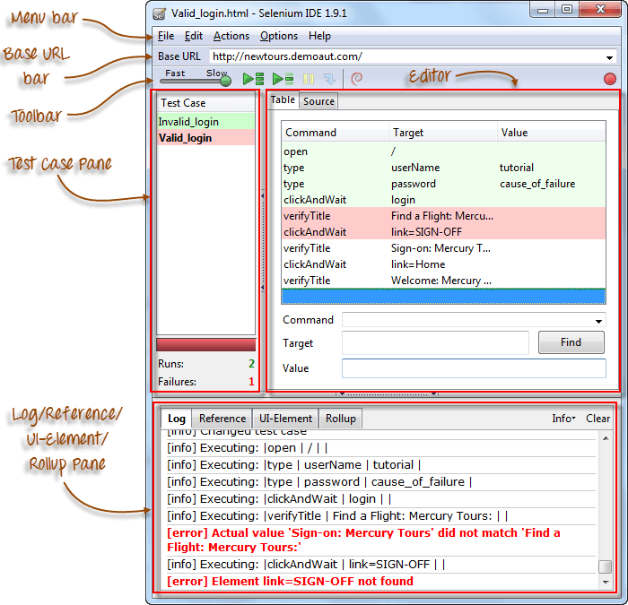

Slide 15
MENU BAR
-It is located at the top most portion of the IDE. The most commonly used menus are the File,Edit and Options Menu
- It contains options to create, open, save, and close tests.
Tests are saved in HTML format.

Slide 16
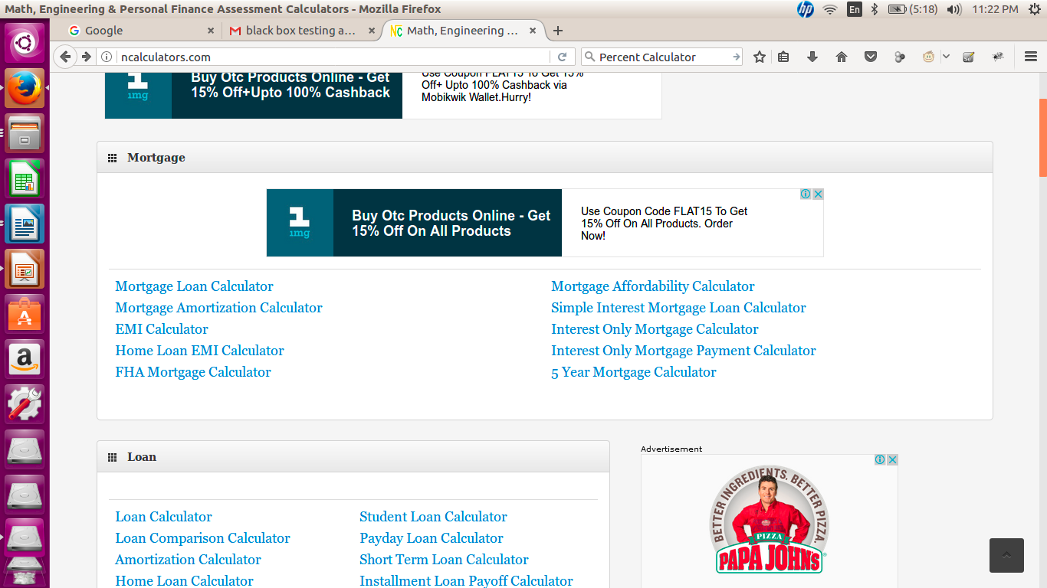
Step 3 : Navigate to "EMI Calculator" under Mortgage
Enter the requuired values to calculate EMI, and click "calculate".

Slide 17
Step 4 : The recorded script is generated and the script is displayed as shown

Slide 18
Saving the Recorded Test
Step 1 : Save the Test Case by navigating to "File" >> "Save Test" and save the file in the location of your choice. The file is saved as .HTML as default.
The test can also be saved with an extension htm, shtml, and xhtml.

Slide 19
Saving the Test Suite
A test suite is a collection of tests that can be executed as a single entity.
Step 1 : Create a test suite by navigating to "File" >> "New Test Suite" as shown below.

Slide 20
Step 2 : The tests can be recorded one by one by choosing the option "New Test Case" from the "File" Menu.
Step 3 : The individual tests are saved with a name along with saving a "Test Suite".

